Slide 1
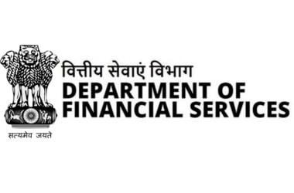


Team Name:
QuackQuackQuack
PS: MK21
Team Members:
Muskan Khandelwal
Ishaan Rawat
– Upgrading Jan-Dhan Darshak app
Anish Jangra
Divya Rawat
Mansi Joshi
Shrey Jain

Slide 2
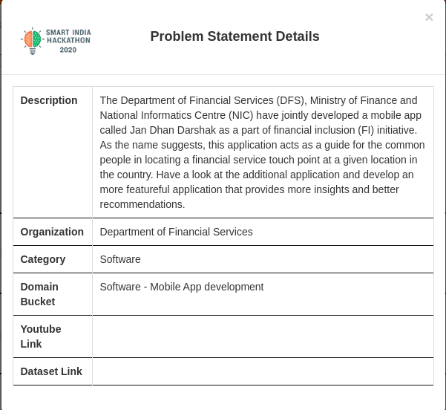

Slide 3
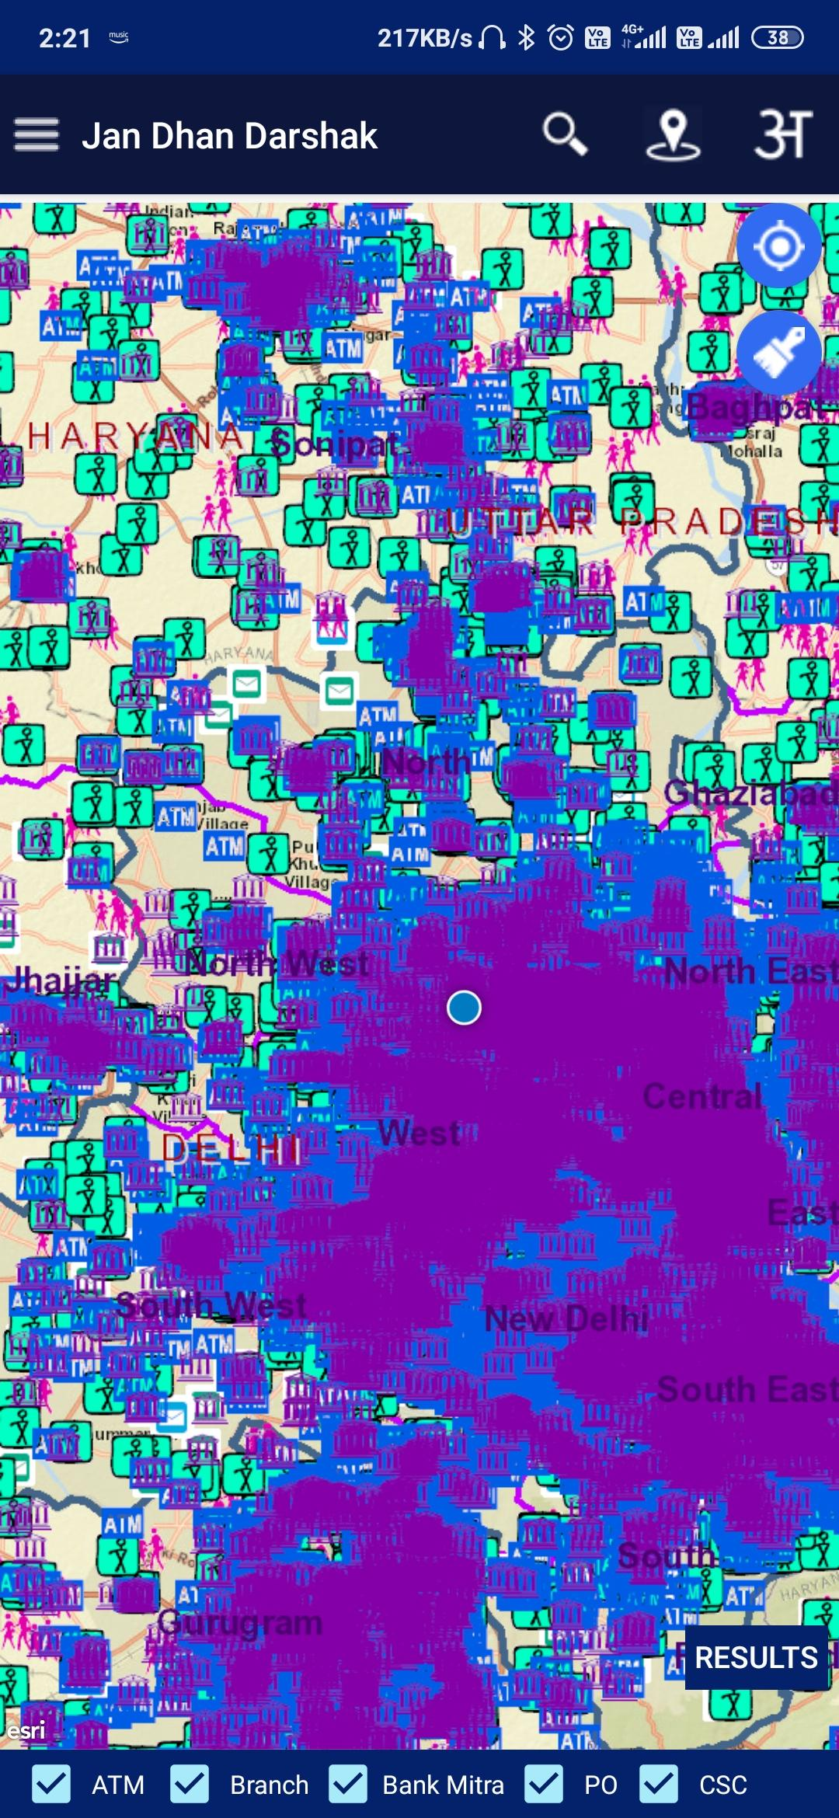


Why update Jan-Dhan-Darshak App: Unresolved & Inefficiently-solved Use Cases
It’s a DATA DUMP!
Too much to Load
Poor Map visibility and inaccuracies Illogical to show ATMs that are 15km away!
Too much to Load
On a slow data connection, Sluggish data retrieval
Slow location detection
No Navigation feature
Location of spots are visible but No OPTION to navigate to any of them
Inaccurate Information
Users found location inaccuracies
Data isn’t dynamic, non-functional ATMs
Nightmare for digitally-challenged users
WHY JDD? Why not Google?
Bad User Experience
Can’t use a smartphone well? Difficult to use the JDD app
Entire map shaded blue & purple UX very troublesome!
Target user base has this segment
“ATMs near me”, “Banks near me”, “Post office near me”
These searches will render more comprehensible results!
Using google is the easiest, it’s dynamic too
Problems with JDD
Design Principles
Re-imagining Func.
Adding New Func.
Summary
| 01

Slide 4



Jan-Dhan-Darshak App, the enabler of Financial Inclusion Initiative (PMJDY/NMFI)
The Principle
How Do We Address It?
Outcomes
Banking the unbanked
1
Locate Nearby Financial Features
Locate Nearby Financial Features Suited To A Common Task (e.g. Withdraw Money)
Digitally-challenged friendly & easy to understand User Interface
This way we’ve served the original purpose of the App
Better Financial Inclusion of People with no idea of how banking system works
More users, whose literacy restricted their inclusion, can now be included!
Securing the unsecured
2
Insurance & Pension policy information, calculation & application section
Locate nearby FTs for finding more information
“Knowledge is Choice, Choice is Power” - More users now know about policies remotely, tackling COVID-19
Policies not only implemented from a bank only, see all available options for it
Problems with JDD
Design Principles
Re-imagining Func.
Adding New Func.
Summary
| 02

Slide 5




Jan-Dhan-Darshak App, the enabler of Financial Inclusion Initiative (PMJDY/NMFI)
The Principle
How Do We Address It?
Outcomes
3
Funding the unfunded
Loan Scheme information, & application section
Locate nearby FTs for finding more information & applying
“Knowledge is Choice, Choice is Power” - More users now know about policies remotely, tackling COVID-19
Policies not only implemented from a bank only, see all available options for it
4
Serving unserved and underserved areas
Feedback forms
Request for FT feature
Collection & Analysis Facility for the request data
Feedback Loop: Users can now give feedback on the FTs, the service providers can now improve
Unserved corners: Requests enable recognition process of the unserved regions
Govt. & the System can now serve the unserved & can understand how to better serve underserved
Problems with JDD
Design Principles
Re-imagining Func.
Adding New Func.
Summary
| 03

Slide 6


Re-imagining & Implementing the Existing Functions:
Existing Feature
Our Implementation
How we Improved the solution?
1
Nearby Financial Touchpoint
Users can select the type of FT they want to look for
We provide a list of nearby FT We allow an easier voice-enabled navigation for the same
Why show the FT in Delhi to someone in Coimbatore?
Users previously had to do deselect all FTs and then select the one they want, now it’s a 2 click process
2
Feedback on only location of FT
Users can only provide feedback regarding the location of a FT
Feedback on the FT is taken
Comprehensive Feedback System
Feedback on location and all other aspects
While location feedback helps improve the app, other feedback helps improve the system!
3
List of multiple Nearby FTs
Users can select any combination of FTs and all data is dumped on a map
Sensical Combinations can be Selected
Only sensical combinations can be selected, making the UI more user friendly
We have made the functionality actually usable for users who are unaware of the financial system
Functionality put to appropriate use!
Problems with JDD
Design Principles
Re-imagining Func.
Adding New Func.
Summary
| 04

Slide 7
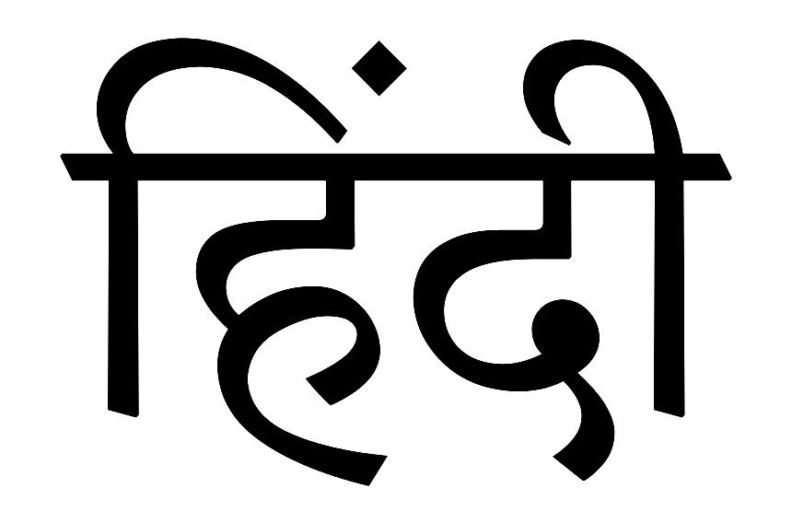

New Functionalities we’ve Added
The Feature
Our Implementation
How It Improved the App?
1
Multi language Support
Using i18n Library
The content of the app is supported in multiple languages
The app now caters to a wider audience!
2
Request for opening more ATM
Users can now raise a request for opening a new ATM.
Backend API
To store, analyse & share the information with the stakeholders
Serving the Under & Unserved
3
Navigation & Call to FTs
Users can now call & navigate to the nearby FTs
Using Google Maps & Phone call API
Most heated user issue (on google playstore) resolved
Problems with JDD
Design Principles
Re-imagining Func.
Adding New Func.
Summary
| 05

Slide 8
New Functionalities we’ve Added
The Feature
Our Implementation
How It Improved the App?
4
Speech-based Navigation
Users can select the type of FT they want to look for
Click a text to make the app read it out loud
We allow an easier voice-enabled navigation for the same
5
The Policy System
A remote way to cover all policies under FII
Our own content-curated dynamically updatable front-end
Users can still take policies even after disruptions caused by COVID-19
6
Collection and Sharing of Data
Non identifiable information, free of data protection regulations
We store only location attributes of a request,
No Personal Information stored!
Provided Insights to Financial Service Providers
7
We Created a Scalable Backend
And used python & hosted it on cloud
Parallel-Processing able server process The multiple servers can run in parallel
We can replicate Govt. Data within a matter of hours and have the app running
Problems with JDD
Design Principles
Re-imagining Func.
Adding New Func.
Summary
| 06

Slide 9
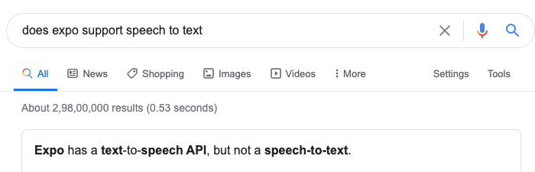

Our Challenge: We Failed, OR DID WE?
No existing API for speech to text translation and we need to implement our own function from scratch
Our Additional Task
| 07

Slide 10
Thank You!

